Slide 1




Basic Details of the Team and Problem Statement
PS Code: PSO3
Problem Statement Title: Web/Mobile-Based Tool for Mapping Water Supply Network in Coimbatore
Team Name: Stark Matrix
Team Leader Name: Sudharshan Vijay S K
Institute Name: Sri Krishna Arts and Science College

Slide 2
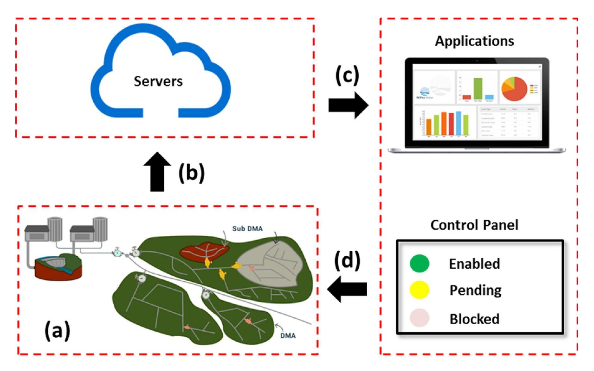
Idea/Approach Details
Idea / Solution:
AquaInsight is an advanced GIS tool for mapping, monitoring, and managing Coimbatore's water supply.
It integrates IoT sensors, real-time monitoring, and user-friendly interfaces.
Key features include GIS-based mapping, real-time monitoring with strategically placed IoT sensors, and a user-friendly interface.
The system provides alerts for anomalies, role-specific notifications, and stores historical data for trend analysis.
AquaInsight aims to revolutionize water management, ensuring sustainability, efficiency, and community involvement.
Additionally, it develops an interactive map with layers for holistic viewing, a robust search function, and real-time monitoring through strategically deployed IoT sensors.
The tool ensures accessibility on web and mobile platforms, an intuitive interface with customizable views, and role-specific alerts.
It includes a communication hub for collaboration, emergency response, and a secure database for storing historical data.
An analytics dashboard supports trend analysis and informed decision-making.
Sample Workflow of AquaInsight
Describe your Technology stack here:
Django
Python
Firebase
ESP 32
Waterflow Monitoring Sensor

Slide 3
Idea/Approach Details
Use Cases here
Dependencies / Show stopper here
Water Quality Monitoring
Real-Time Monitoring for Leak Detection
Emergency Response Planning for water conservation and management.
Predictive Maintenance
Offers a user-friendly interface accessible to residents.
GIS tool visualizes the water supply network components.
Water Demand Planning.
Trend Analysis for Resource Allocation.
AquaInsight integrates a communication hub for stakeholders in decision making.
Dependencies :
Data Accuracy and Availability
Reliable IoT Sensor Deployment
Integration with existing water supply infrastructure and GIS databases is critical
Availability and reliability of technology infrastructure
Security and Privacy Compliance
Show stoppers :
Resistance to change or inadequate training may hinder user acceptance.
Issues in sensor deployment, such as technical malfunctions or insufficient coverage, could impede monitoring capabilities.
Advanced spatial analysis functionalities, such as overlays or geoprocessing, can add complexity to the GIS tool,

Slide 4
Team Member Details
Team Leader Name: Sudharshan Vijay S K
Branch (Btech/Mtech/PhD etc):BSc Stream (ECE, CSE etc): Data Science Year (I,II,III,IV): III
Team Member 1 Name: Sailesh B
Branch (Btech/Mtech/PhD etc): BSc Stream (ECE, CSE etc): Data Science Year (I,II,III,IV): III
Team Member 2 Name: Javid Hussain A
Branch (Btech/Mtech/PhD etc): BSc Stream (ECE, CSE etc): Data Science Year (I,II,III,IV): III
Team Member 3 Name: Aathi Raghul G
Branch (Btech/Mtech/PhD etc): BSc Stream (ECE, CSE etc): Data Science Year (I,II,III,IV): III

